Slide 1

Dynamic Graph Isomorphism
Moiz Ansari - 23I-0523
M. Abdullah Siddiqui - 23I-0617
M. Daniyal - 23I-0579

Slide 2
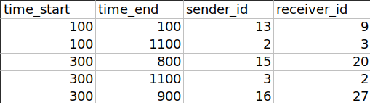
Data Preparation: Understanding the Input Dataset
Dataset Overview:
The input dataset represents football matches as a sequence of passes.
Each pass includes the following attributes:
Start Time (time_start): When the pass begins.
End Time (time_end): When the pass ends.
Sender ID (sender_id): The player making the pass.
Receiver ID (receiver_id): The player receiving the pass.

Slide 3
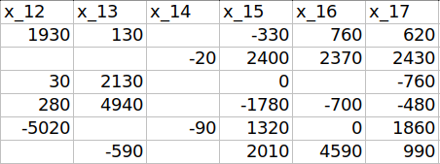
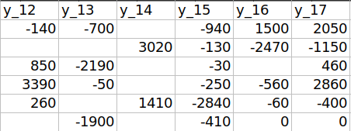
Data Preparation: Understanding the Input Dataset
Dataset Overview:
The player positions are represented by x and y.
The positions of team A ranges from 1 to 14, meanwhile the positions of team B ranges from 15 to 28

Slide 4
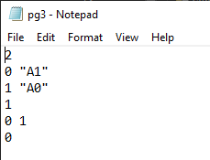
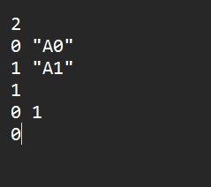
Data Preparation: Understanding the Input Dataset
Dynamic Graph Representation:
Players are nodes (vertices), and passes are edges in a dynamic graph.
The dataset encapsulates temporal information, making it ideal for analyzing evolving team strategies.
A0
A1
A16
A18

Slide 5
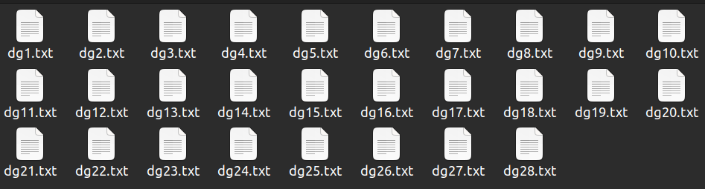
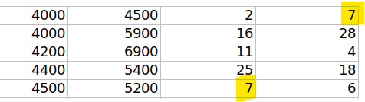
Strategy for Segregating Passes into Matches
Segregation Strategy:
Divide the dataset into 14 matches, assuming the data includes all passes from multiple games.
Passes are assigned to a match based on:
Time Order: Passes are processed sequentially to ensure logical continuity.
Connectivity: The receiver_id of one pass must match the sender_id of the next pass in the match.
Notes:
In previous solution there was a concept of timestamp that when a pass happened it makes a timestamp at that edge.
But in Oberoi solution, the concept of snapshot based model is used in which graphs at different times are compared.
More precise and chronological order comparison.

Slide 6

Strategy for Segregating Passes into Matches
Handling Edge Cases:
If no match is found for a pass in the same time range, it is either:
Assigned to a new group.
Marked as a separate isolated play.
Result:
Each match’s passes are grouped logically, preserving the flow of gameplay.
Notes:
In previous solution there was a concept of timestamp that when a pass happened it makes a timestamp at that edge.
But in Oberoi solution, the concept of snapshot based model is used in which graphs at different times are compared.
More precise and chronological order comparison.

Slide 7
Adapt the Technique: Understanding and Modifications to Oberoi's Code
Understanding Oberoi’s Code:
The provided code is designed to detect dynamic subgraph isomorphisms.
Input:
Dynamic graphs (represented as sequences of nodes and edges).
Notes:
Comparison with Mackey and TemporalRl algorithms
Better runtime and success rate for subgraph isomorphism
Runs better at large data sets

Slide 8
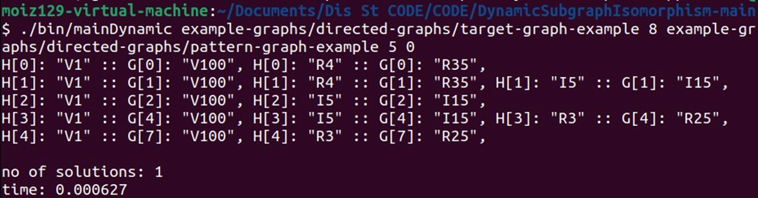
Adapt the Technique: Understanding and Modifications to Oberoi's Code
Understanding Oberoi’s Code:
Output:
Matches isomorphic substructures to identify recurring patterns.
Notes:
Comparison with Mackey and TemporalRl algorithms
Better runtime and success rate for subgraph isomorphism
Runs better at large data sets

Slide 9
Adapt the Technique: Understanding and Modifications to Oberoi's Code
Modifications:
The Oberoi’s code input files were of the format (dgX.txt and pgX.txt), so we created files according to the file format and prevented to change the original code.
Converted raw data into dynamic graphs using the prescribed csv file
Adjusted edge cases to ensure compatibility with the dynamic graph format.
Adjusted the output to focus on football-specific insights.
Notes:
Comparison with Mackey and TemporalRl algorithms
Better runtime and success rate for subgraph isomorphism
Runs better at large data sets

Slide 10
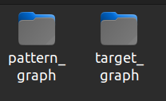
Demonstration of the Working (Without Code)
Input Preparation:
The raw dataset (passes) is processed into:
Target Graphs: Representing the passes of one team.
Pattern Graphs: Representing possible sub-patterns or passing sequences.

Slide 11
Demonstration of the Working (Without Code)
Example:
Input:
A CSV file with passes for all matches.
Output:
Each match folder contains files (dgX.txt, pgX.txt) structured as:
Number of vertices
Vertex details
Number of edges
Edge details
Graph Visualization:
Dynamic graphs are created to visualize:
Player-to-player passing patterns.
Temporal evolution of team strategies.

Slide 12
Code Implementation: Converting Input to Desired Output
Parsing Input:
Reads the dataset into memory and extracts key attributes.
Segregation into Matches:
Divides passes into logical groups based on time and connectivity.

Slide 13
Code Implementation: Converting Input to Desired Output
Dynamic Graph Construction:
Converts passes into vertices
and edges using the format ------>
File Generation:
Creates folders (target_graph, pattern_graph).
Writes graph files for each match in the appropriate format for target_graphs.
The pattern_graph files are hardcoded from the Bourgeas’ papers.

Slide 14
Identify Key Passing Patterns and Comparison
Analysis Results:
The code identifies key passing patterns:
Frequent subgraphs (e.g., triangular formations or star patterns) are detected.
Temporal variations in passing intensity are visualized.
Figures:
Graphs similar to Figure 3 and 4 in Bourgeais’ paper:
Compare team strategies based on positional play and passing structures.
Highlight differences between high-possession and counter-attacking teams.

Slide 15
Identify Key Passing Patterns and Comparison
Comparison of Strategies:
Team A:
Emphasizes triangular passing structures in the midfield.
Team B:
Relies on direct, long passes to break through defenses.
Insights:
Visualization aids coaches in understanding tactical differences.
Suggests adjustments to exploit opponent weaknesses.

Slide 16
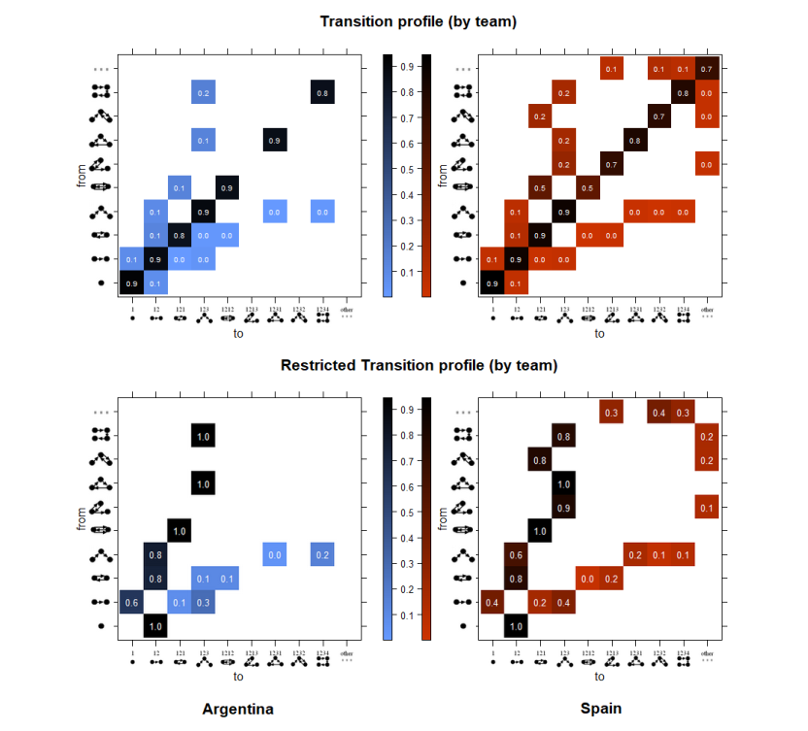
BOURGEAS PAPER: FIG 4
Transition Entropy
Probability of state changing
Probability between 0-1
Reading graph by Row-Column

